Slide 1
Mapping of successful Widening countries & key elements of Excellence Hubs
Francesca Cervelli, Policy Officer, DG Research & Innovation
Federica ROFFI, Deputy Head of Unit - European Research Executive Agency
1st EH Club Conference
June 17, 2025

Slide 2

Painting by B. MESTER
Outline
Widening Programme Objectives
Excellence Hubs Expected Outcomes
Mapping of Widening Actions
EH Survey Outcomes
Steps towards EH Community/ Impacts

Slide 3
Widening Programme Objectives
The main objectives of Widening Participation and Spreading Excellence Programme (Horizon 2020 and Horizon Europe) are to support less advanced R&I countries to strengthen their R&I intensity and performance, to increase their participation in transnational networks and, overall, to obtain greater research outcomes in low performing EU Member States & Associated countries:
Widening Member States: Bulgaria, Croatia, Cyprus, Czech Republic, Estonia, Hungary, Latvia, Lithuania, Luxembourg (only in H2020), Malta, Poland, Portugal, Romania, Slovakia, Slovenia and Greece (new in HE)
Widening Associated Countries: Albania, Armenia, Bosnia and Herzegovina, Canada, Faroe Islands, Iceland, Israel, Kosovo, North Macedonia, Georgia, Moldova, Montenegro, New Zealand, Norway, Serbia, Tunisia, Turkey, UK and Ukraine.
* Outermost Regions eligible in HE: France (Guadeloupe, French Guyana, Martinique, Mayotte,
Saint-Martin, La Réunion), Spain (Canary Islands), Portugal (Azores Islands, Madeira)

Slide 4
Excellence Hubs – expected outcomes
Excellence hubs focus on innovation by allowing innovation ecosystems in widening countries and beyond, to team up and create better linkages between academia, business, government and society (Quadruple Helix)
Strong and sustainable research and innovation ecosystems in Widening countries and other regions, focusing on advanced science and innovation.
Long-term joint research and innovation (R&I) strategies with clear, concrete plans that are relevant to Europe.
Shared investment plans including infrastructure, combining national, regional, European, and private funding in a coordinated way.
R&I pilot projects aligned with joint strategies and regional or national goals, especially the smart specialization strategies (RIS3) and the new European Innovation Agenda.
New skills and competencies for researchers, entrepreneurs, and professionals working in high-tech and R&I-intensive areas.
(…)
Notes:
smart specialisation (RIS3) -Guidance is structured around six practical steps:
Analysing the innovation potential
Setting out the RIS3 process and governance
Developing a shared vision
Identifying the priorities
Defining an action plan with a coherent policy mix
Monitoring and evaluating.

Slide 5
Excellence Hubs – expected outcomes
(…)
Stronger connections between science and business to drive innovation.
Improved knowledge transfer and development of entrepreneurial skills to support innovation.
New business opportunities, particularly for SMEs, university spin-offs, and start-ups, especially in deep tech.
Inclusion of emerging innovation ecosystems from rural areas, the EU Outermost Regions, the Western Balkans, Eastern Partnership countries, and Ukraine, supported by optional mentoring programs.

Slide 6
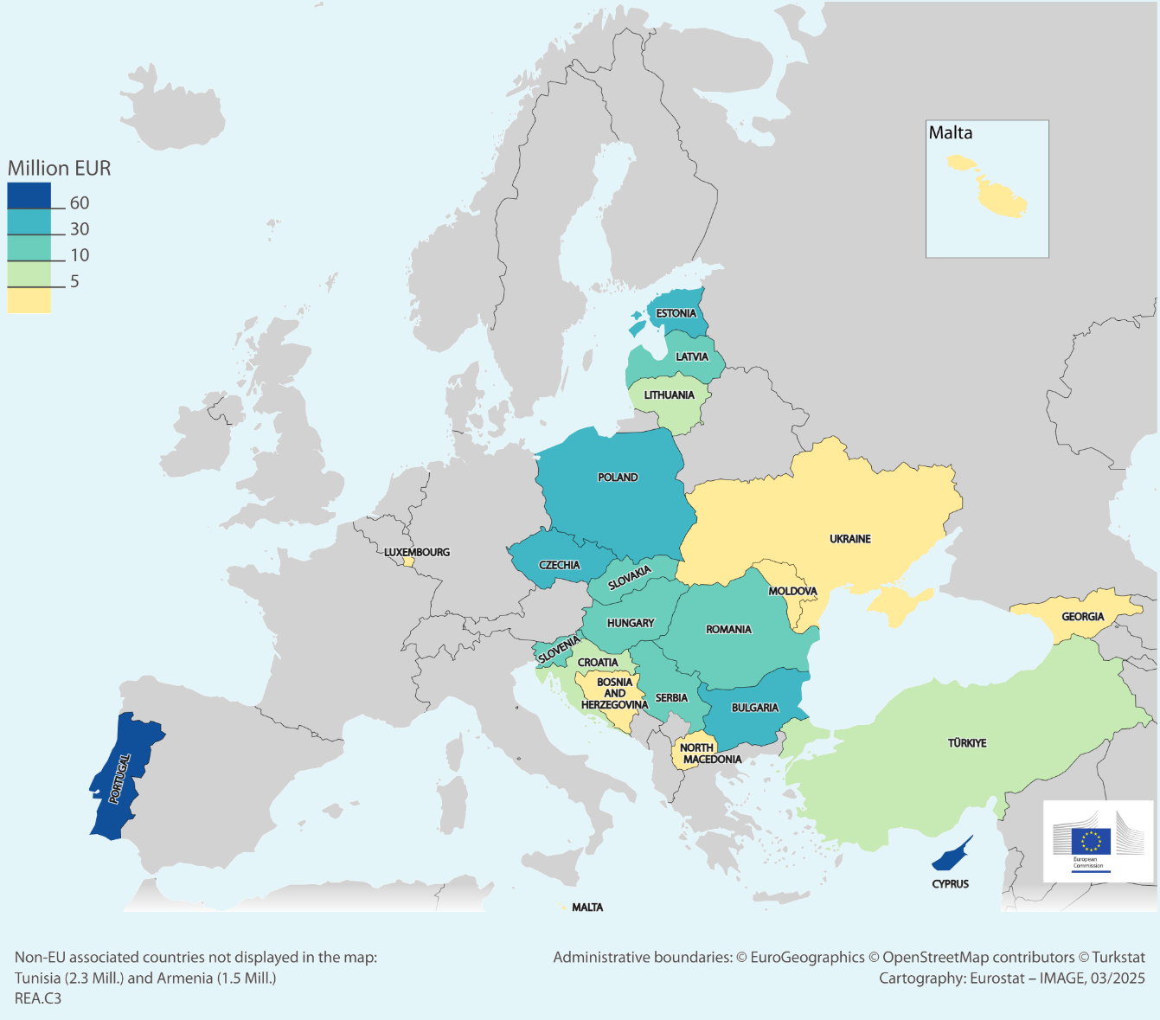
EU Contributions to Widening countries
(Widening programme H2020)
15 calls computed from:
Twinning
Teaming
ERA Chairs
ERA Fellowships
Total budget distributed: 551 Mill €

Slide 7
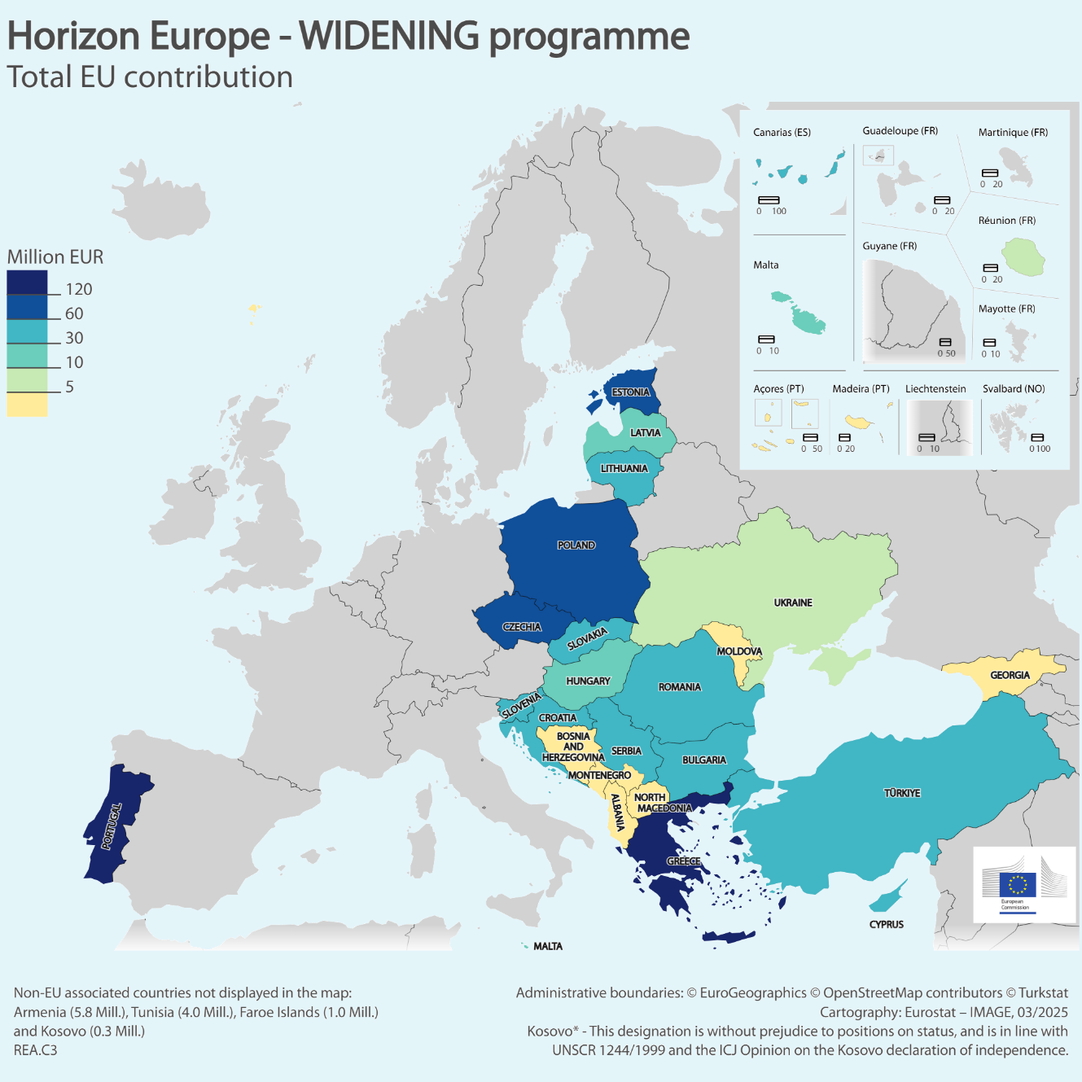
EU Contributions to Widening countries
(Widening programme HE)
23 calls computed from:
Teaming
Twinning
Twinning WB
ERA Chairs
ERA Fellowships
ERA Talents
Europ. Excellence Init.
Excellence Hubs
Hop-On Facility
R&I policy in WB
Pathways to Synergies
Dissem. & Expl. Facility
Total budget distributed: 995 Mill €
Outermost Regions: ES70 – Islas Canarias; FRY4 - La Réunion; PT20 – Açores; PT30 – Madeira

Slide 8
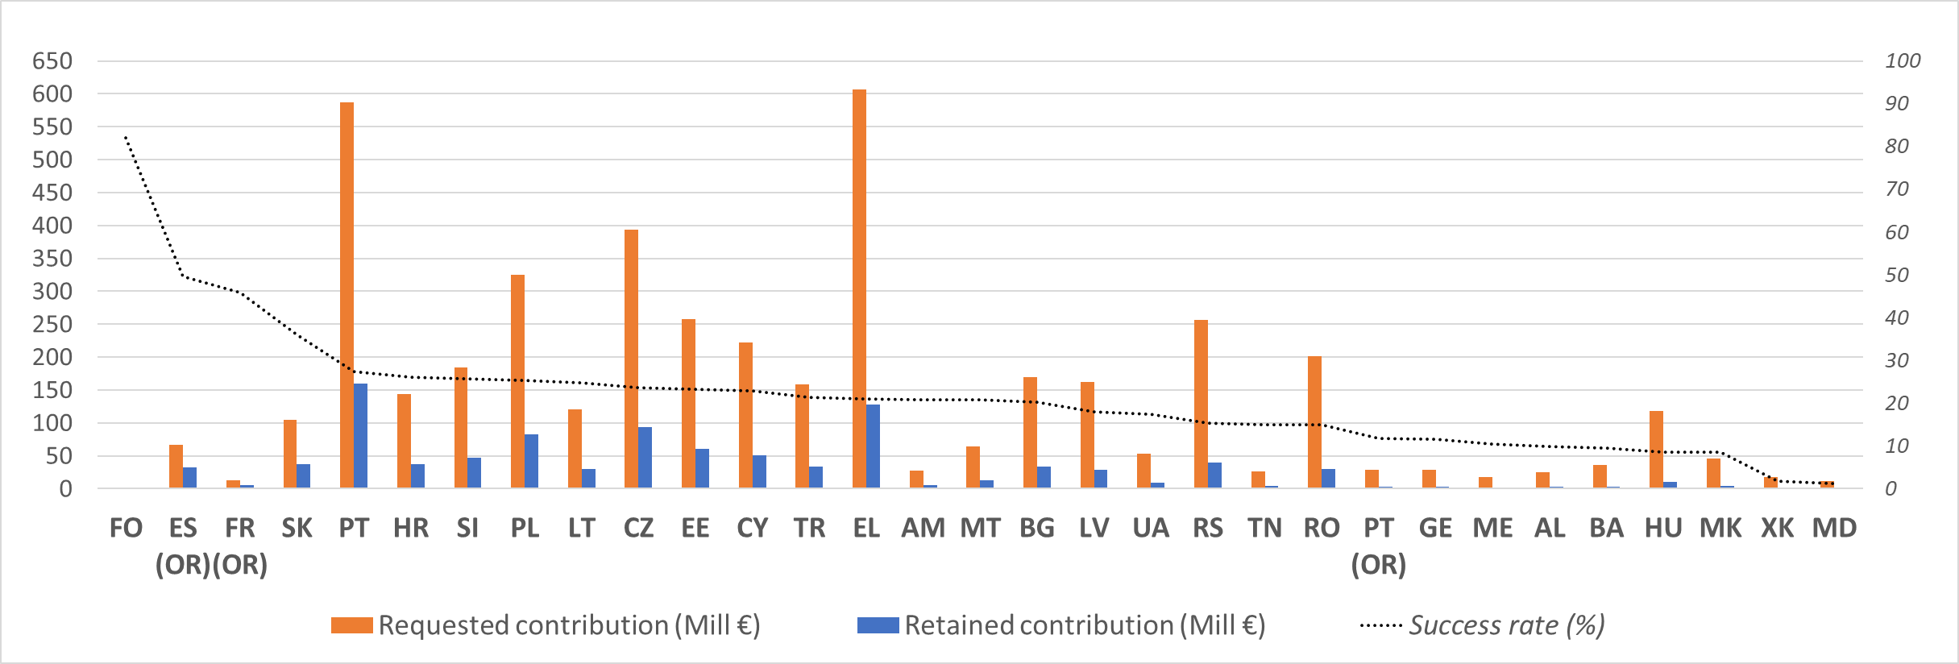
EU Contributions´ Success Rate of Widening countries
WIDENING programme in Horizon Europe (23 Calls of Proposals)
(OR) = Outermost Region as of Art. 349 TFEU
Average success rate (22%)
Total budget of submitted proposals: 4,479 Mill €
Total budget retained: 995 Mill €
Note: Only eligible projects and countries requesting an EU contribution are considered

Slide 9
Excellence Hubs Survey

Slide 10
EH 2024 Survey Distribution
Target: One representative from each EH project beneficiary
EH Call: HORIZON-WIDERA-2022-ACCESS-04
Anonymity ensured: Participants remained anonymous to encourage candid responses.
Survey distributed to: 191 participants.
Response rate: 113 responses (~60%).

Slide 11
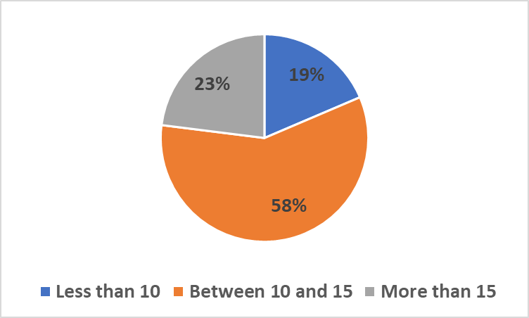
Size of Consortium in 13 EH Projects

Slide 12
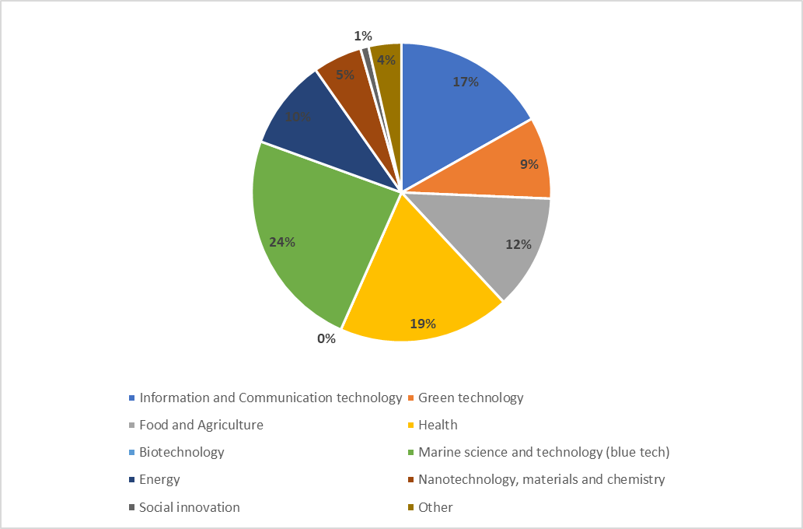
Thematic Sectors of EH Projects
Top Three Fields:
Marine Science, Health and ICT

Slide 13
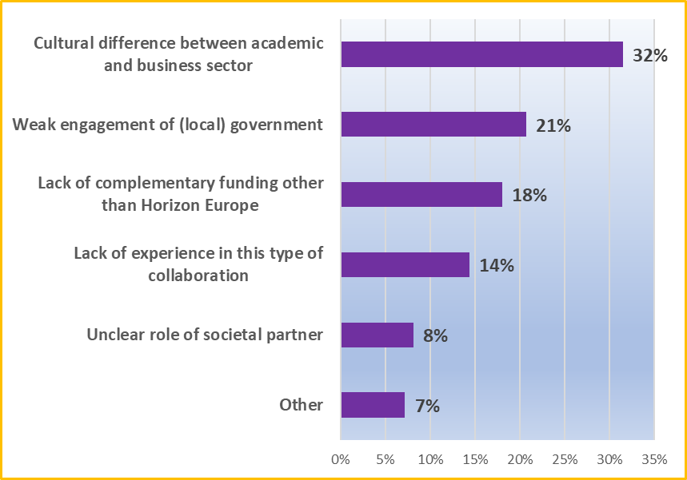
Main Barriers to Integrate the Quadruple Helix

Slide 14
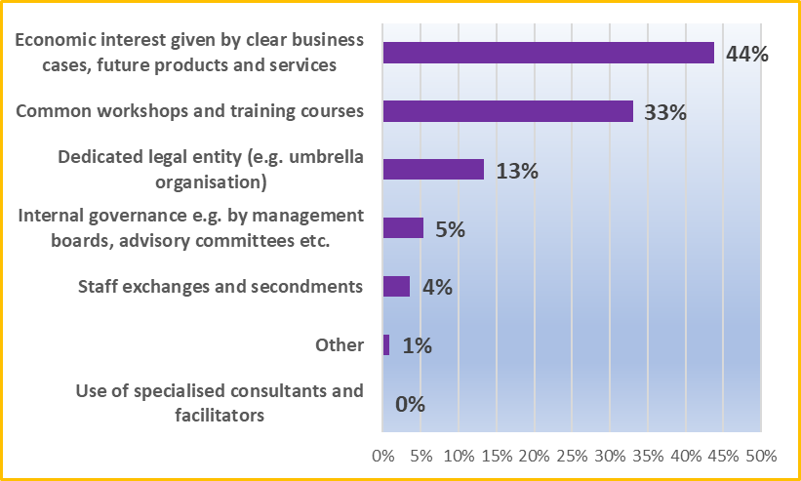
Strategies/ methods which facilitate collaboration between the 4 actors of the quadruple helix

Slide 15
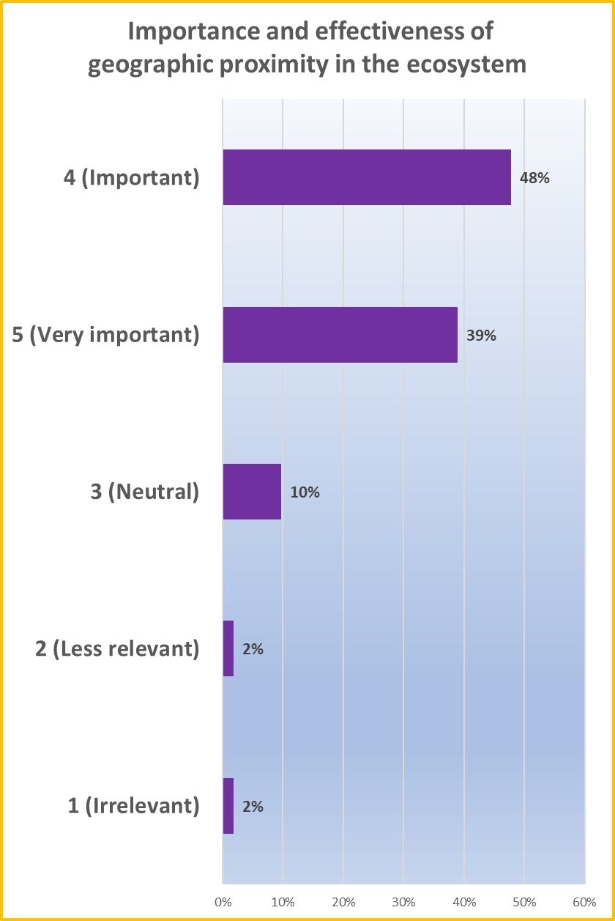
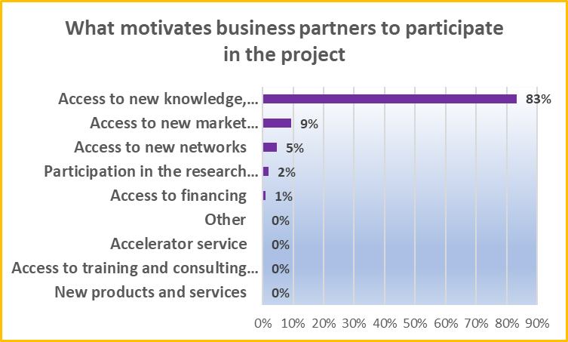

Slide 16
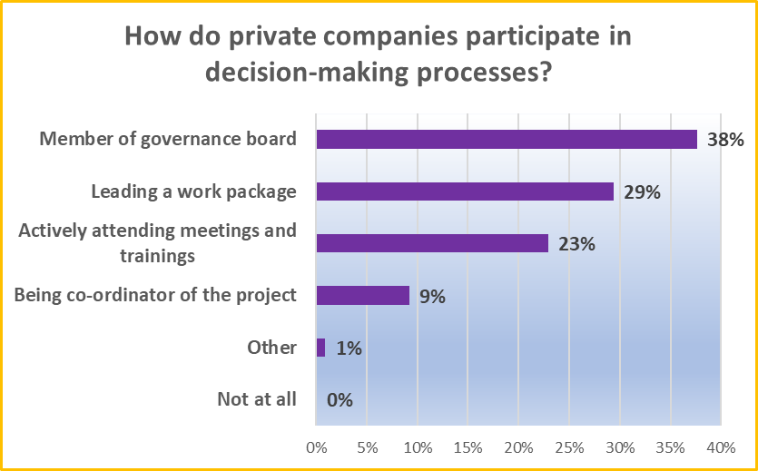
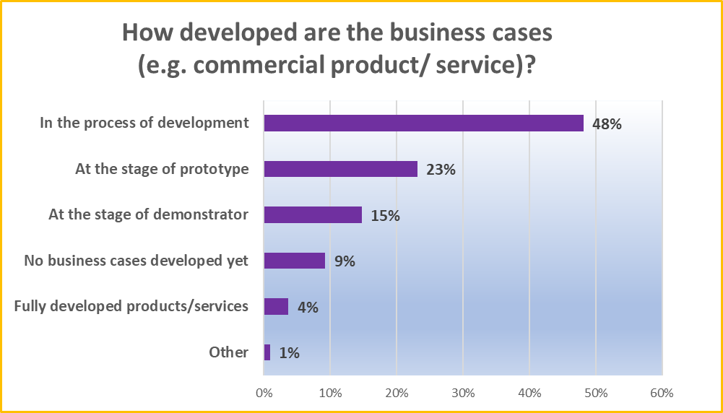
Commercialisation & business cases

Slide 17
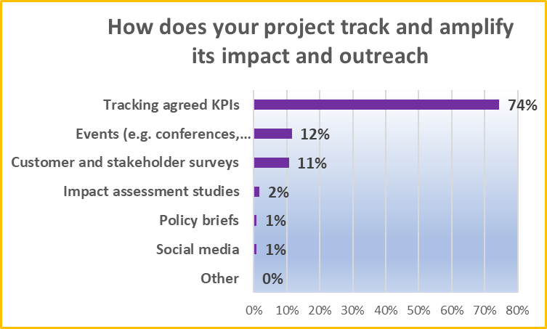
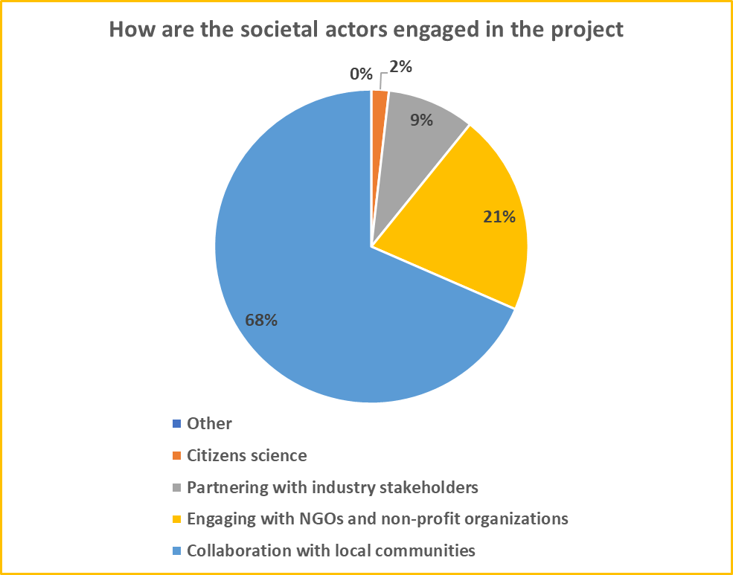
Outreach & Impact

Slide 18
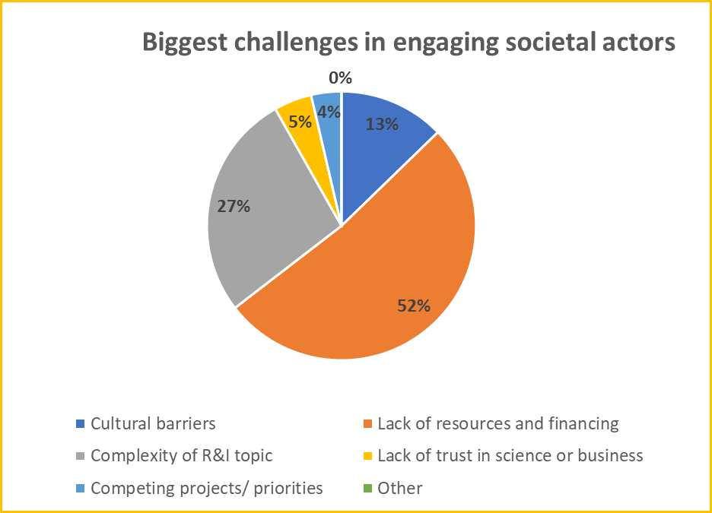
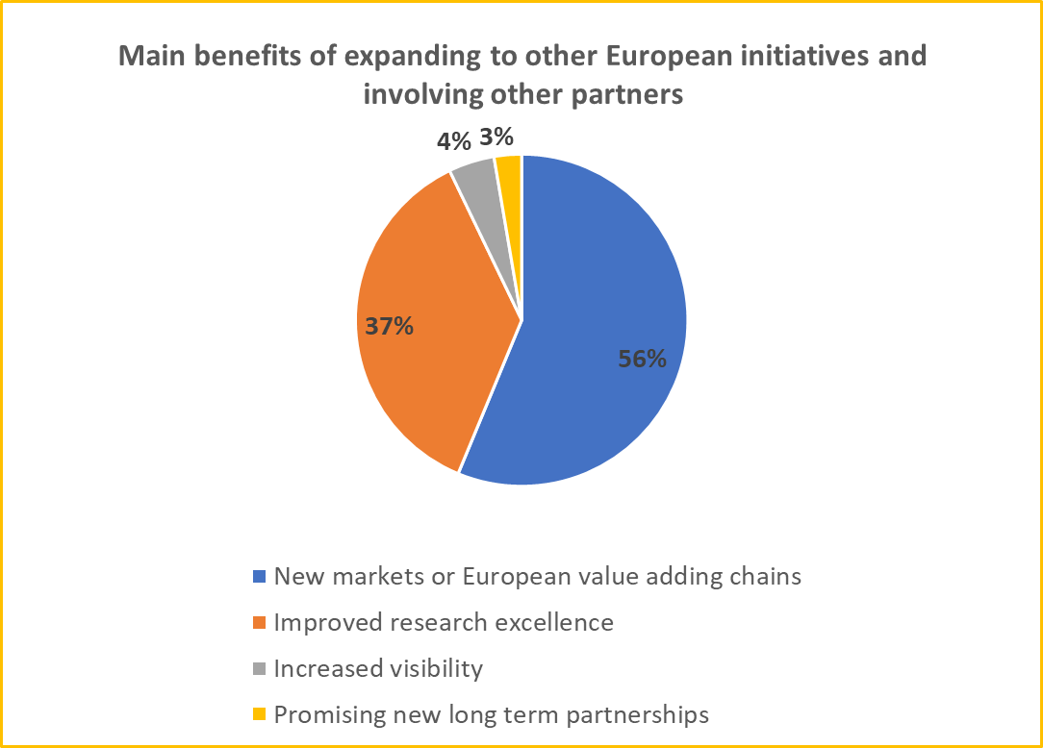
Challenges & Benefits

Slide 19
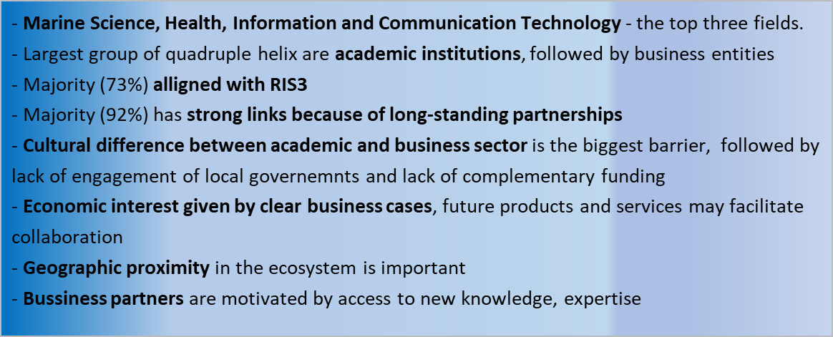
Take-Away Messages

Slide 20
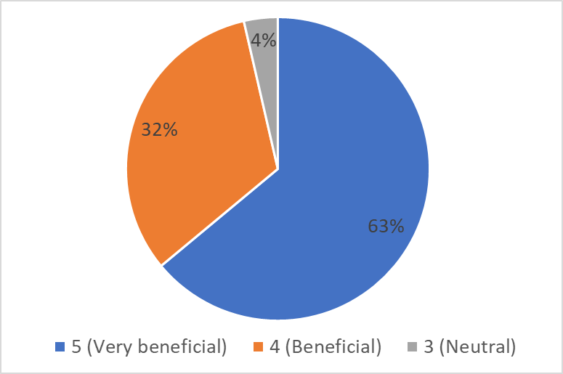
How beneficial would the creation of an EH community/ network ?

Slide 21
Steps towards building of EH Community
EH Survey: May, 2024 – 13 projects (interest in building EH Community)
EH Policy Workshop: October, 2024 (initiative of SolarHub to coordinate EH Community)
EH Community Kick-Off Meeting - today, 17th June, 2025
EH Survey July, 2025 – all 24 projects (July 2025: sharing EH impacts)
EH Community activities as a part of larger Widening Impacts

Slide 22

Paining by B.Mester
Thank you!
# HorizonEU
http://ec.europa.eu/horizon-europe

